Slide 1
You can download the slides here mrreddy.com/mathsconf6.pptx
Do Now (as in now now)
What sort of culture do you want?
List up to 5 words associated with the culture you want in your classroom.

Slide 2
What sort of culture do you want?

Slide 3
Classroom Culture Comes First

Slide 4
Best Maths Teachers ace…
Culture
Questioning
Modelling
John Mason
Maths Hubs

Slide 5
Culture
Questioning
Modelling

Slide 6
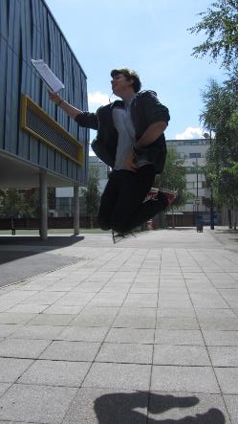
GCSE Maths Results
2014
95% C+
75% B+
40% A+
2015
95% C+
82% B+
55% A+

Slide 7
Jigsaw Design
Whole school
Maths dept.

Slide 8
Culture
What is it?
Where does it start?
How do you create it?

Slide 9
What is culture?
What you stand for (values)
+
How you express that (language+actions)
Bruno Reddy (2016)
What you say and don’t say.
What you do and don’t do.

Slide 10
Where does it start?
At.
The.
Beginning.

Slide 11
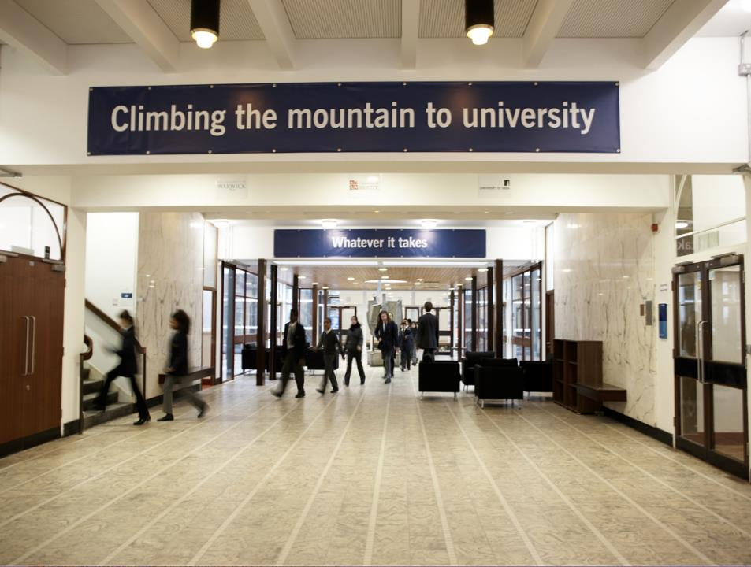

Slide 12
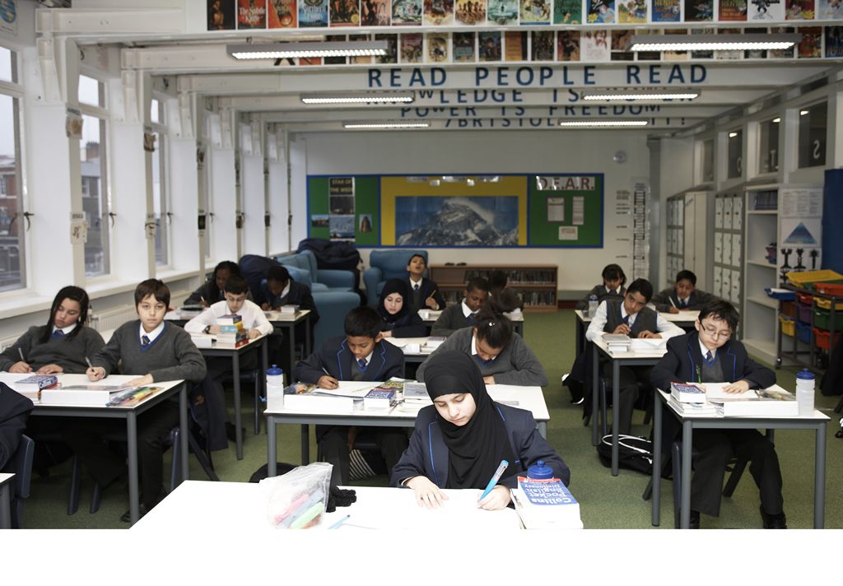

Slide 13
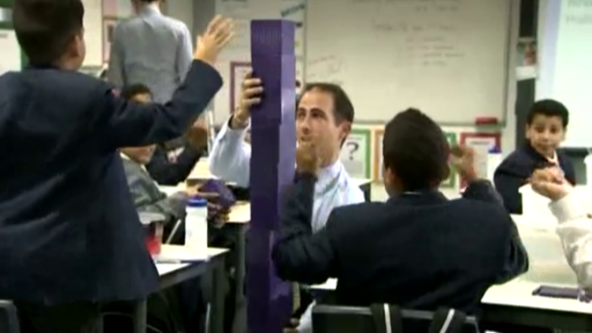
What sort of culture do I want?
Secure
High-performing
Professional
Youthful

Slide 14
Before the beginning…
What culture is evident in your prospectus?
What culture is evident in your open evenings?
What culture is evident on your year 6 days?
It’s on the walls, it’s the examples you set, it’s what you ask pupils to do or don’t do (and what you do about it when they do or don’t), it’s in your tone.

Slide 15
The beginning…
Culture begins imprinting from minute 1 of day 1.

Slide 16
Lesson 1
3 goals
Routineering
Visioneering
Expectation setting

Slide 17
1. Routineering

Slide 18
Routines
Entry into the lesson
Do Now

Slide 19
Entry into the lesson
Describe what your school’s expectations for entry routines.
Are all departments or classes doing the same?
What do the most effective lesson starts look like?
What do the least effective lesson starts look like?

Slide 20
Entry routine – why?
Getting lessons off to an efficient and productive start sets the rest of the lesson up for success.
It’s an opportunity to remind pupils about the high expectations in our classrooms.

Slide 21
An example entry routine
Student | Teacher
As you enter the classroom have eye contact with your teacher and say good morning or afternoon Ms/Sir Move straight to seat in silence Bag on floor, equipment and planner out on the table Compete Do Now in silence | Have do now ready on board/on tables or assigned to a student to hand out Ready at door to greet pupils Maintain eye contact, say good morning/afternoon Take register in silence and record minutes late
How might this apply in primary schools?

Slide 22
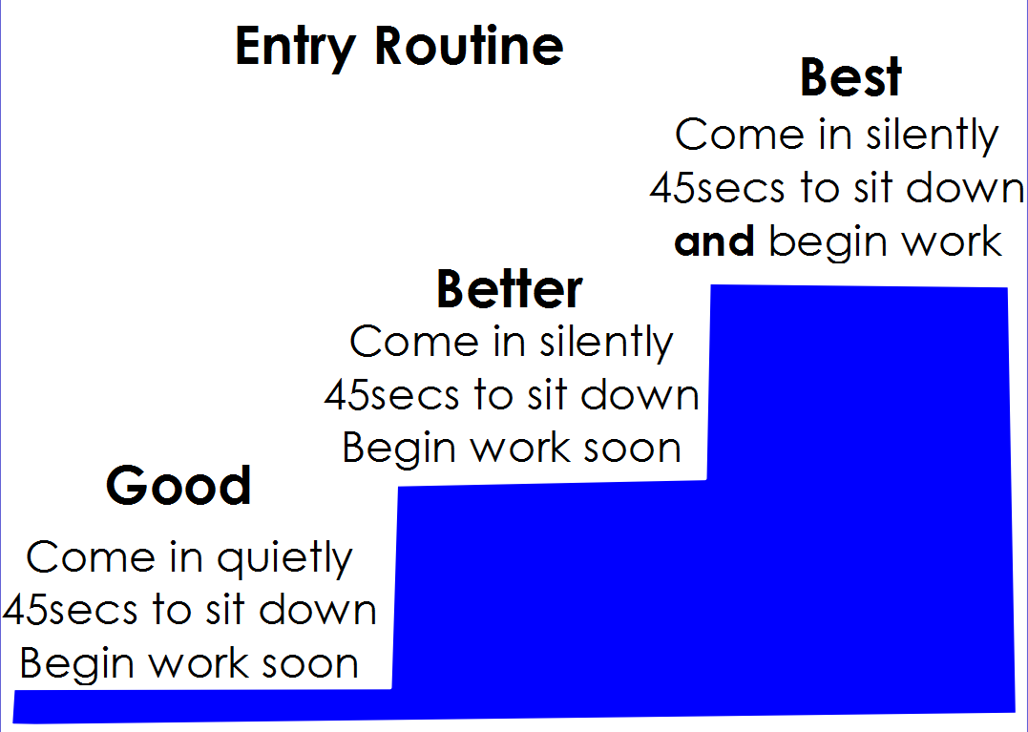

Slide 23
So how might you establish an entry routine tomorrow?
Let’s give it a go now.

Slide 24
Rehearse entry routine with your class in lesson 1
Enter as normal
Complete starter
Talk about the new routines and the reasons for them
Restart the lesson with the new entry routine and make your high expectations clear
Acknowledge pupils, groups or the whole class when its done well

Slide 25
Your turn
Imagine standing in front of your class
You’re going to explain the rationale for your new entry routine
And then describe the entry routine step by step
Then get them to rehearse it successfully

Slide 26
Your turn
15 seconds to decide which class you want to imagine
In pairs or triples
One person to be the teacher
Teacher to practice their speech (time limit 2 minutes)
Class feedback
Same teacher re-run (time limit 2 minutes)

Slide 27
A word about Starters/Do Nows

Slide 28
Do Now
Effective Do Nows are completable without direction from the teacher (to get them off to a productive start and to give you the chance to set things up for the lesson).
We want pupils to feel successful at the beginning of the lesson and give the first few minutes maximum purpose.
Pitch it right! If lots of hands go up or talking begins then it was probably too hard or too novel.

Slide 29
2. Visioneering

Slide 30
Visioneering
Play a video of last year’s results day
Tell them a story with their eyes closed
Place a dummy results certificate on their desk
Let the sense of possibility fill them with dreams.

Slide 31
Go BIG on the dream. It’s *always* about hearts and minds.

Slide 32
3. Expectation setting

Slide 33
Expectations
If your school or department isn’t clear on precisely what you should expect then you better be ☺

Slide 34
In other words

Slide 35
Grow a pair of non-negotiables

Slide 36
Two basic expectations
100%
Every second counts

Slide 37
Note…
While these are non-negotiable expectations, the method for achieving them is totally negotiable.

Slide 38
Play Year 5 clips

Slide 39
100%
There’s one acceptable percentage of students following a direction: 100%.
Teacher radar – You must be keenly aware of how students respond to your directions.
Danger – moving on without compliance causes students to see noncompliance as an option.
Tolerating marginal compliance will also have a corrosive effect.
If you ask, they should do it.

Slide 40
Hold out for 100%
Don’t move on. Instead, try…
Do it again
Be seen looking
Pope
John Wayne
President
Invisible column
Blame It On The Boogie
Acknowledging those who are doing it right
It’s great the way … is …
I am appreciating the way … is …
Nothing but love for … who is …
Do it *every* time.
Notes:
Where’s the best place in the room to stand?
And when you’re helping them at their table?

Slide 41
Least invasive forms of correction
Nonverbal intervention
Positive group correction
Anonymous individual correction
Private individual correction
Lightning-quick public correction
Consequence

Slide 42
Your turn
In your rows, one of you is the teacher.
Teacher stand up
Students are working on something.
Teacher call the class back together to move the lesson on. Not all students comply. Teacher, you must get 100% attention before moving on.
Swap if there’s time

Slide 43
Every Second Counts
VAT instructions
Seat signals

Slide 44
Clear Instructions
V olume
A ctivity
T ime
Keep instructions succinct
Get a pupil to repeat

Slide 45
Your turn
In pairs, one of you is the teacher.
Teacher stand up
Give V A T instructions for the task/activity they’re about to do.

Slide 46
Seat signals
Claps to silence
Two claps to say well don
Sit up
Turn around
Empty hands

Slide 47
Lesson 1 Checklist
Seating plan
Pumped up for visioneering + video + certificates
Ready to explain and model routines and expectations
Ready to get 100%
Ready to smile!

Slide 48
Summary
Get the culture right and the learning follows
Culture-setting begins the moment they’re outside your room
Have a consistent entry routine with high expectations for a productive start
Win hearts and minds
Hold out for 100%
Remember that every second counts

Slide 49
If there’s time left…

Slide 50
Rolling Numbers

Slide 51
9s
Teacher: So I’ve been telling everyone how good you are at maths.
Class: No lies! True say!
Teacher: Can you roll your nines?
Class: Yes! [Both fists up]
Teacher: Team! Team! Good as gold! Let me see your fingers roll... the nines!
Class: Yeah! 9-18-27-36-45-54-63-72-81-90-99-108
[counting off on fingers as you go]
Teacher: (Nod)
Class: Whoomph! There it is! I said whoomph! There it is!

Slide 52
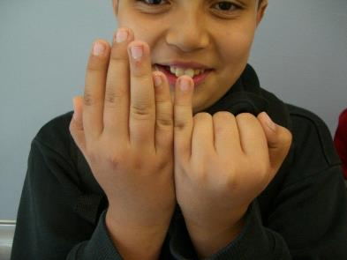
3s
Teacher: Team! Team! Good as gold, let me see your fingers roll the threes!
Class: Yeah! [Both fists up] 3, 6, 9, 12, 15, 18, 21, 24, 27, 30 AAAAAAAND 33, 36!
Uh-huh! This team’s got it going on, going on, oh yeah!

Slide 53
6s
Teacher: Team! Team! Good as gold, let me see your fingers roll the sixes!
Class: Yeah! [Both fists up] 6, 12, 18, 24, 30 [Pause and pose]
36, 42, 48, 54, 60
And Team _______ says…!
66, 72, how do you do? How do you do?
We can roll our 7s too!

Slide 54
7s
Teacher: Team! Team! Good as gold, let me see your fingers roll the sevens!
Class: Yeah! [Both fists up] [Army Style] 7, 14, 21 [Stomp! Stomp!] 28 and 25 [Stomp! Stomp!]
42 and 49 [Stomp! Stomp!] 56 and 63 [Stomp! Stomp!]
70! [Both palms up!] 77, 84! [Stomp! Stomp!]
If you want we’ll give you more! [Stomp! Stomp!]

Slide 55
8s
Teacher: Team! Team! Good as gold, let me see your fingers roll the eights!
Class: Yeah! 8-16-24-32-40
40 down here (punch palm once) 40 up there (palms up)
48 (punch palm twice) 56 (punch palm twice) 64-72-80
80 down here (punch palm once) 80 up there (palms up)
88 (punch palm twice) 96 (punch palm twice)
(Now stop suddenly with your arms folded.)

Slide 56
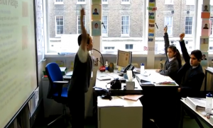
The Pencil Pledge

Slide 57
The Pencil Pledge
Teacher: Pencils ready!
Class: [Bang table with pencil 2 times and then shoot your arm in the air]
Teacher: This is my pencil!
Class: This is my pencil!
Teacher: There are many like it!
Class: There are many like it!
Teacher: But this is MYYYY pencil!
Class: But this is MYYYY pencil!
Teacher: And I use it to do…
Class: Maths!
Teacher: So today is our day!
Class: So today is our day!
Teacher: To. Do. More. And. Be. More.
Class: To. Do. More. And. Be. More.
Teacher: 1!
Class: 2!
Teacher: 3!
Class: Go!
Teacher: Go!
Class: Go!

Slide 58
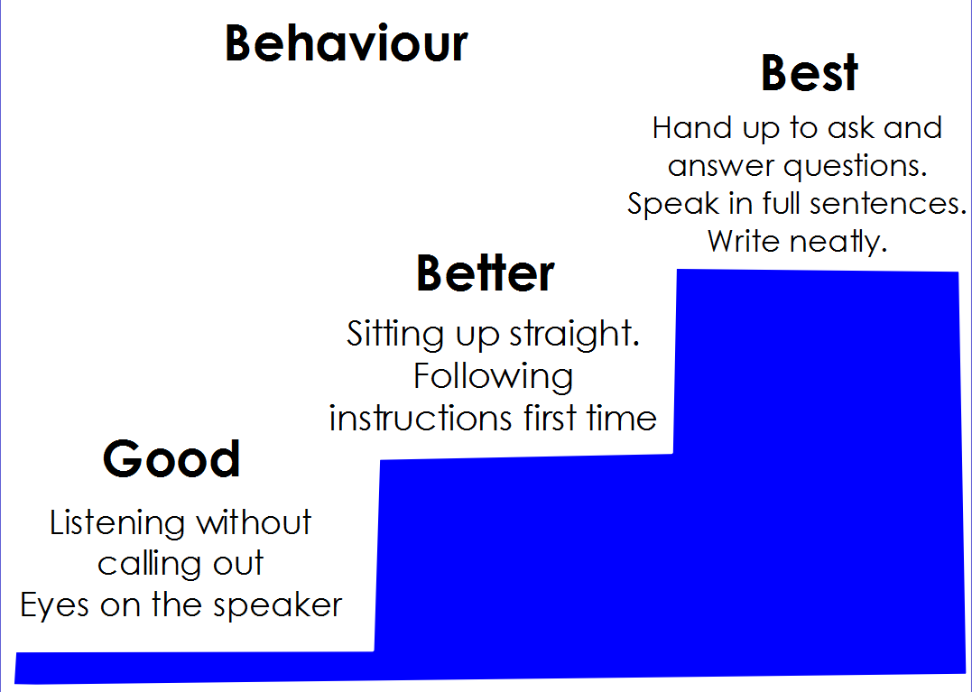

Slide 59
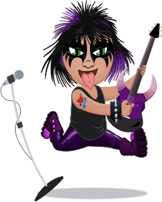
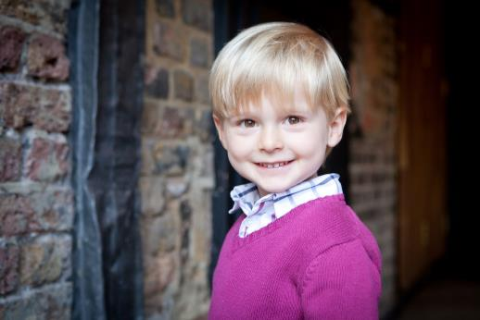
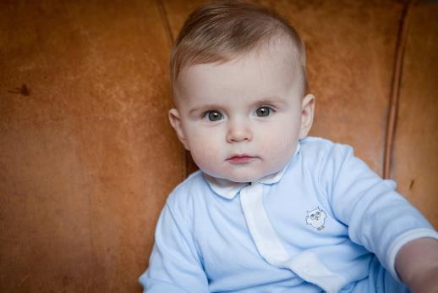
Φ
Phi
Notes:
About me

